Slide 1
Bacterial Changes in Bagged Romaine Lettuce After the Use By Date
Hilal Samut
BIOMI6300
April 30, 2025

Slide 2
Introduction
Leafy greens are highly perishable and one of the most wasted commodities
  Nearly 70% of leafy greens are wasted
Major driver of food waste for leafy greens: Confusion over date labeling
  Use By: the date after which a product is no longer remaining sufficient quality and should not be consumed, but not necessarily associated with food safety
  Best Before/Best if Used Before: the date after which a product loses the best quality for consumption
  Sell Before: the last day on which a product should be sold
Many consumers discard produce past these dates, even if the food remains safe and of acceptable quality
Microbial spoilage plays a key role in food loss
The abundance of spoilage microorganisms increased in alfalfa after 3 weeks of cold storage at 4°C
Research Gap: Limited knowledge of microbial changes after Use By Date
Notes:
study analyzing microbial communities on bagged chopped Romaine lettuce across different seasons and storage durations.
Although fruits and leafy greens are vital components of a healthy diet, they are also highly perishable and heavily wasted foods. Studies show that up to 70% of leafy greens are wasted before they reach consumers. In the U.S., about 31% of total food produced in 2010 — valued at over 160 billion dollars — was lost, with vegetables ranking second among the most wasted food groups.
One major driver of this waste is confusion over date labeling — particularly terms like “Use By” and “Best Before.” Many consumers discard produce past these dates, even when the food remains safe and of acceptable quality.
Microorganisms are a key factor in food spoilage. Previous studies have characterized bacterial communities on fresh produce at or before the “Use By” date. However, little is known about microbial dynamics after this date.
To fill this gap, we evaluated the microbiome of bagged chopped Romaine lettuce on the Use By date and five days afterward, using both culture-dependent and 16S rRNA sequencing methods.
Our goals were to understand how seasonality and extended storage affect microbial composition and diversity.

Slide 3
Objectives
Characterize bacterial communities on bagged Romaine lettuce
Compare samples:
  Early (Fall) vs. Late (Spring) season
  Use By Date (UBD) vs 5 days-post UBD
How does the microbial biodiversity in chopped Romaine lettuce change with (i) storage duration and (ii) harvest season of lettuce?
  Null hypothesis: The microbial biodiversity doesn’t change with storage duration and harvest season.
  Alternative Hypothesis #1: A rich microbial biodiversity is expected in chopped lettuce tested at the UBD samples possibly due to die-off .
  Alternative Hypothesis #2: A rich microbial biodiversity is expected in chopped lettuce harvested in warmer seasons.

Slide 4
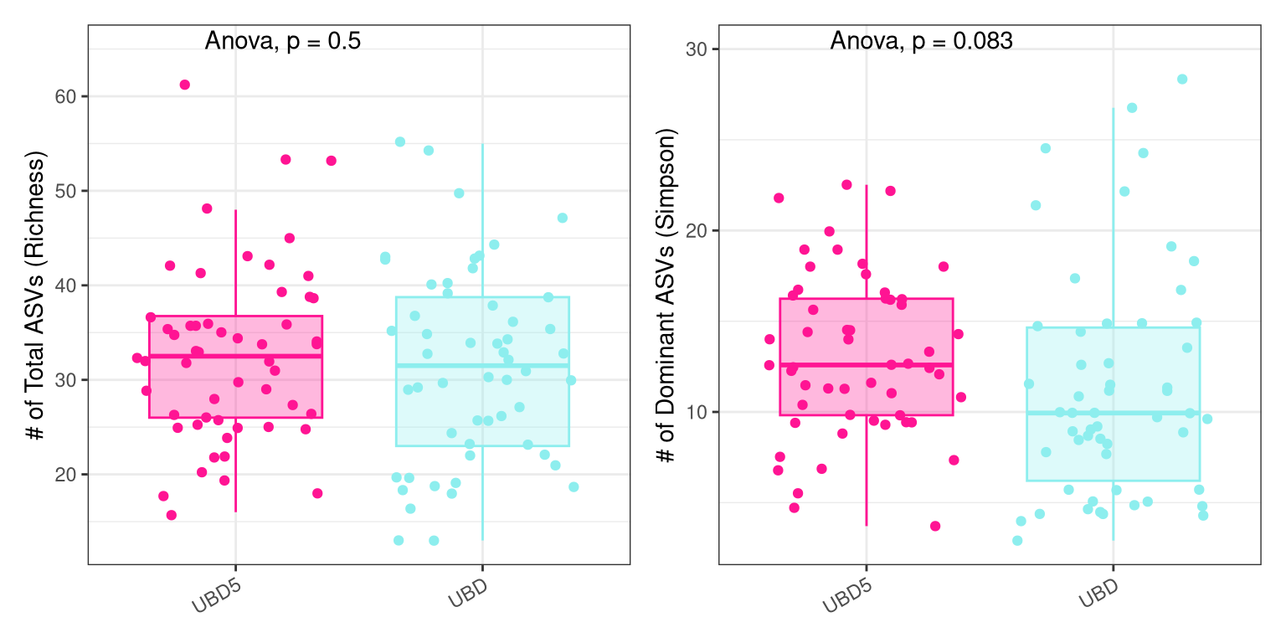
Romaine stored 5-days-post UBD had slightly higher richness and had more dominant members.
Storage duration:
Richness (q = 0): UBD5 samples tend to have slightly higher richness than UBD samples. However, the difference is not very strong. Lettuce samples stored beyond their UBD may have slightly higher microbial richness.
Simpson (q = 2): UBD5 samples showed higher Simpson diversity compared to UBD samples. In terms of dominant community members, lettuce samples becomes more diverse by a few taxa 5 days beyond the use by date, suggesting a shift in the microbial community where no single group outcompetes others better.

Slide 5
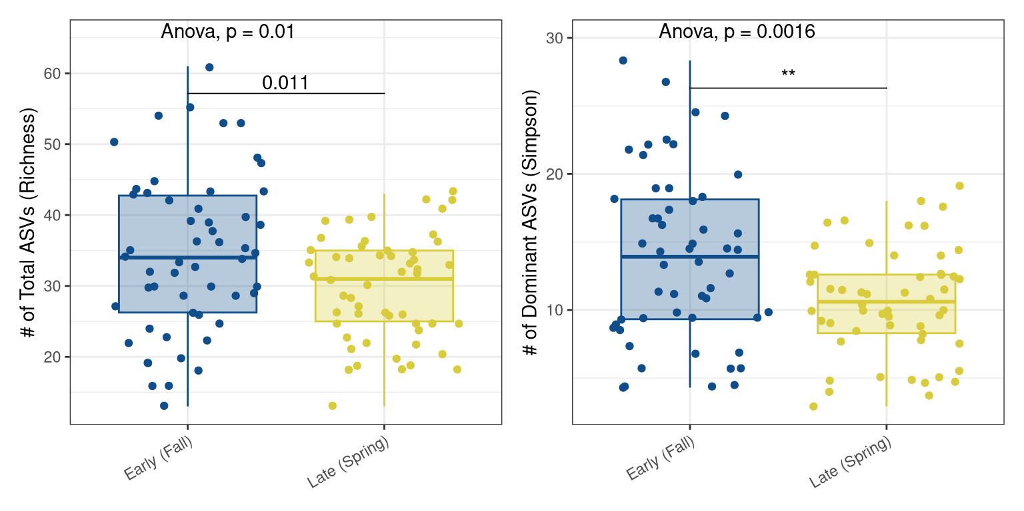
Romaine harvested in early season had significantly higher richness and had more dominant members.
Seasonal effects:
Richness (q=0): Early (Fall) samples have higher ASV richness compared to Late (Spring) ones, which means more unique ASVs were detected in Fall samples. Seasonal differences seem to affect rare species presence and Fall season has more diverse but possibly rare microbial communities.
Simpson (q = 2): Early (Fall) samples showed higher Simpson diversity compared to Spring (Early) samples. In terms of dominant community members, Romaine displayed more diverse community members, so this suggests that dominant species were similar across seasons, though still more diverse in Fall.

Slide 6
How does the microbial biodiversity in chopped Romaine lettuce change with (i) storage duration and (ii) harvest season of lettuce?
Null Hypothesis: Microbial composition does not differ (i) for prolonged storage durations after UBD for chopped Romaine lettuce and (ii) between harvest seasons
Alternative Hypothesis #1:
  Microbial composition during prolonged storage is driven by presence or absence of rare taxa (i.e., Sorensen), with increased dissimilarity in the samples collected in UBD5 samples.
  Dominant members of the microbial community (i.e., Bray-Curtis) are unique in UBD5 samples.
Alternative Hypothesis #2:
  Presence or absence of rare taxa drives seasonal differences in microbial composition (i.e., Sorensen), with increased dissimilarity in the samples collected in late/spring seasons.
  Dominant members of the microbial community (i.e., Bray-Curtis) are unique in late/spring seasons.
Notes:
Alternative #1 Hypothesis is related to presence/absence, whereas Alternative #2 Hypothesis is related to dominant members of the community.

Slide 7
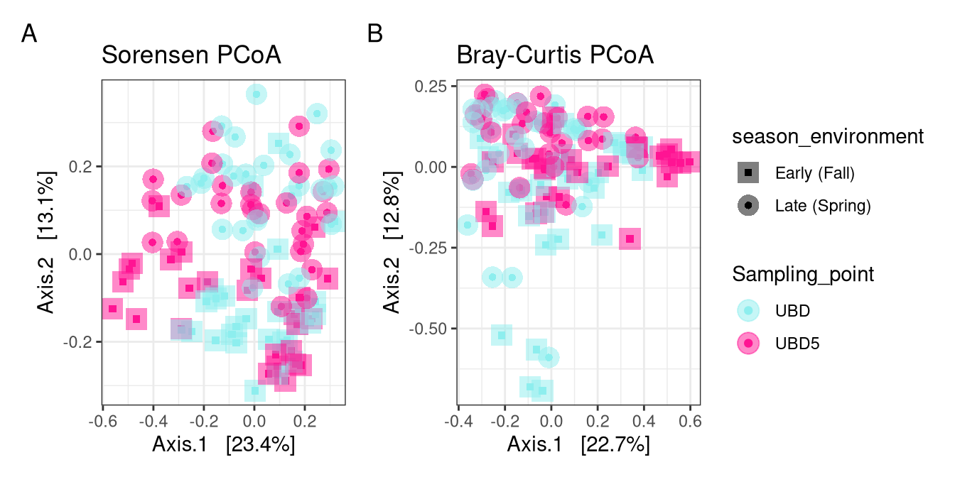
Harvest season drives microbial community shifts on chopped Romaine, while storage duration plays a minor role.
Harvest season explained the largest proportion of the variation in microbial community
The time of year (i.e., fall vs spring) plays a key role in determining which microbial taxa are present on chopped Romaine lettuce.
The seasonal shifts may reflect differences in environmental conditions (e.g., ambient temperature, rainfall, field management) influencing microbial colonization and persistence.
Storage time significantly influences microbial composition explaining only a small proportion of variation.
Temporal microbial changes during storage are less impactful than the differences introduced by harvest season.
Sorensen Dissimilarity:
Season: R² ~9%, p-value <0.001
Storage: R² ~3%, p-value <0.001
Bray-Curtis Dissimilarity:
Season: R² ~9%, p-value <0.001
Storage: R² ~4%, p-value <0.001
Notes:
the total residiuals of the model is ~88% of the variation remains unexplained by these variables, which is higher than 85%.
Betadispers was significant in bray-curtis

Slide 8
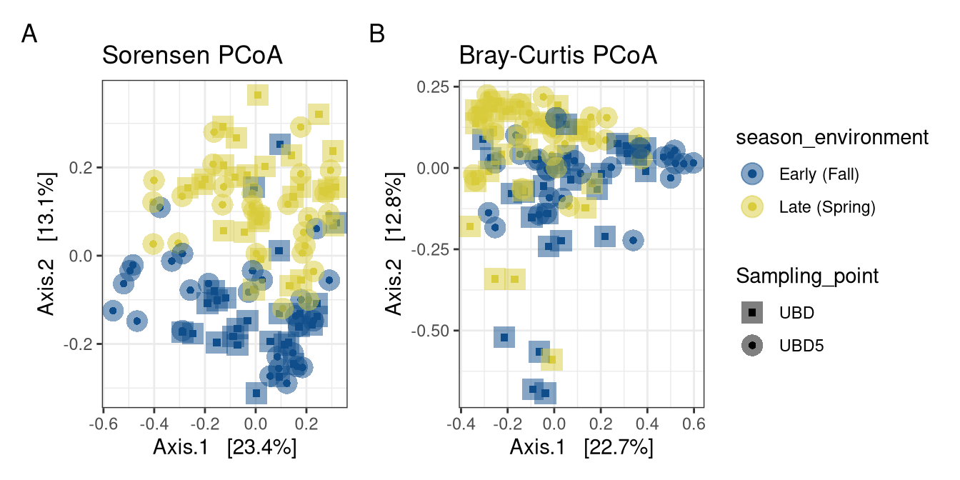

Slide 9
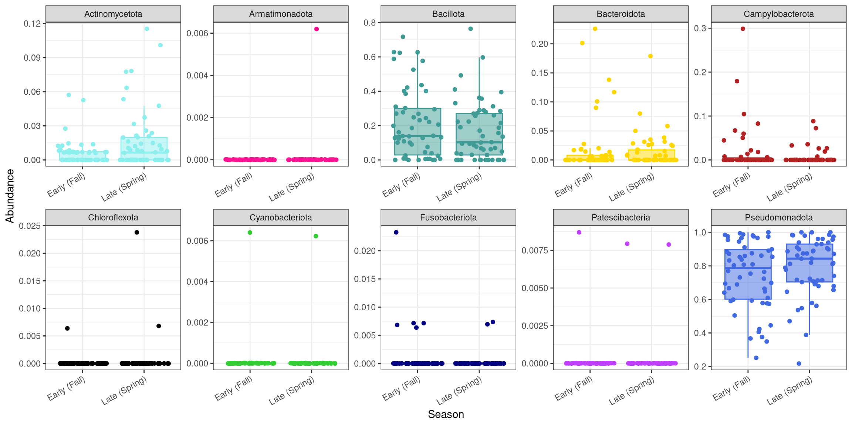
Pseudomonadota was the most abundant phylum in chopped Romaine.
Microbial community composition varied modestly between harvest seasons in chopped Romaine.
While several phyla appear stable across seasons, others show potential slight shifts in relative abundance.
This suggests subtle ecological filtering driven by seasonal environmental conditions (e.g., temperature, field microbiota, or post-harvest handling differences).

Slide 10
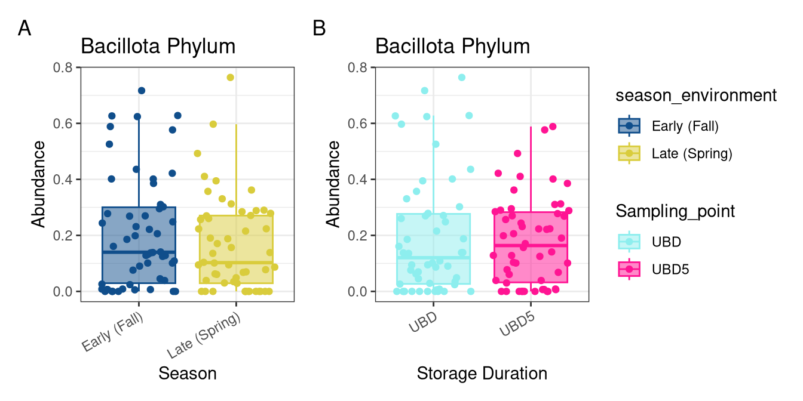
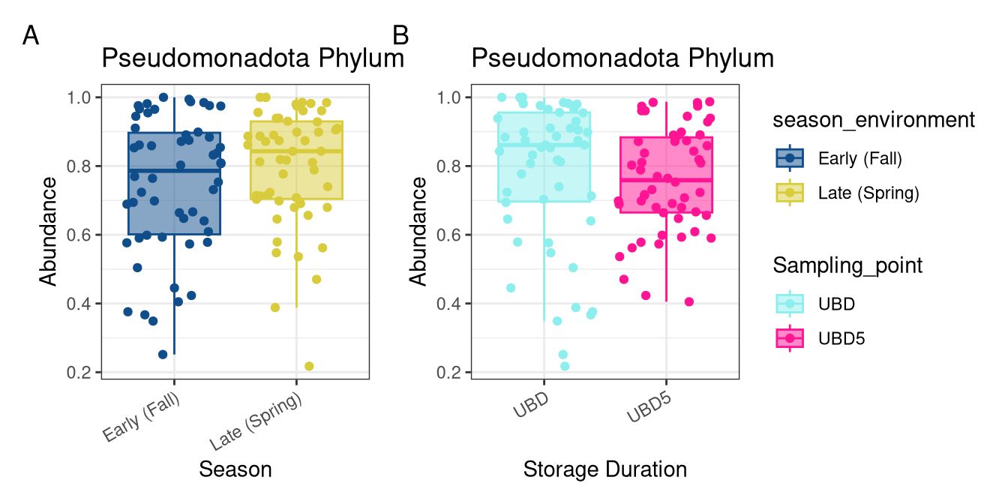

Slide 11
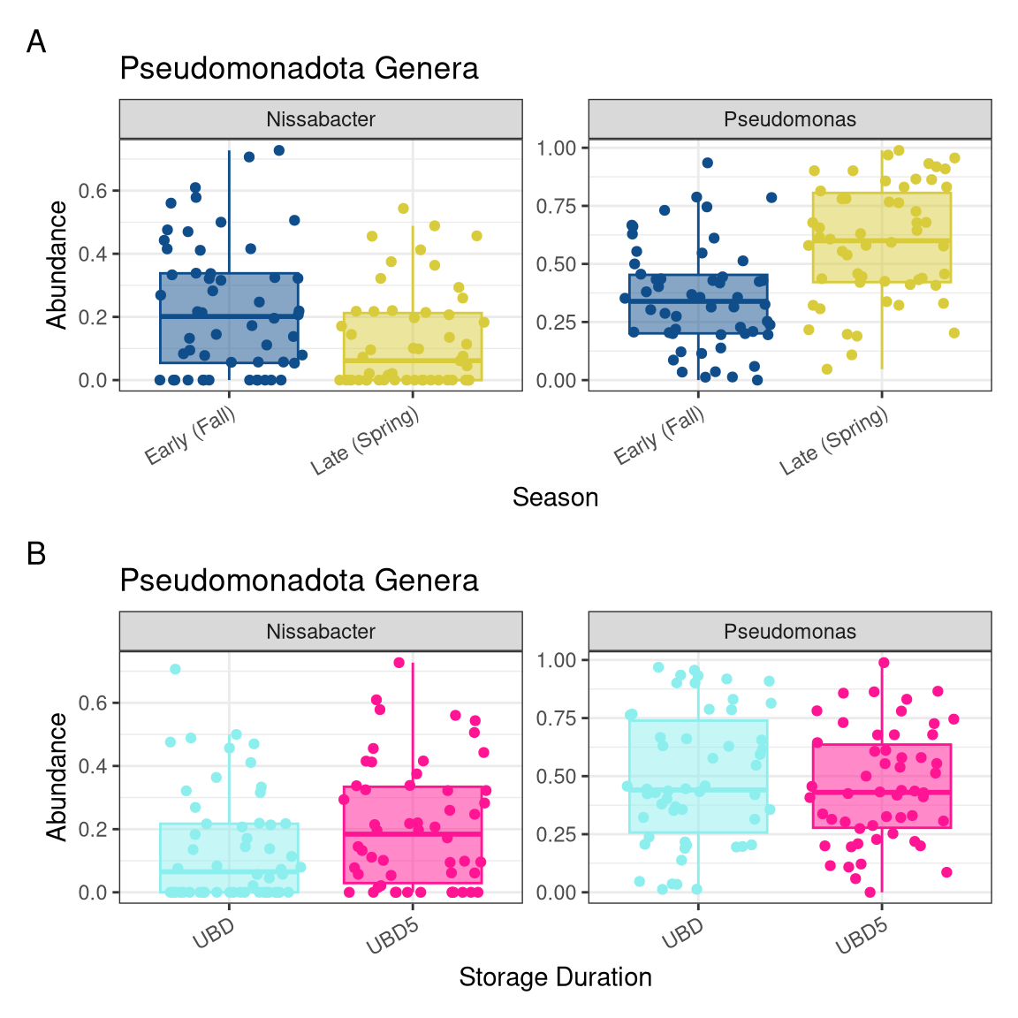
Genus Pseudomonas remained abundant and stable across storage.
Pseudomonas: Genus Pseudomonas drove the dominance of Pseudomonadota and increased in Late Spring, mirroring the seasonal trend seen at the phylum level. Pseudomonas is primarily responsible for the seasonal shift. Its stable presence across storage durations suggests strong resilience and potential roles in spoilage or cold adaptation.
Nissabacter: Contrary to the Pseudomonadota trend, Nissabacter decreased in Late Spring, despite overall phylum abundance being stable or increasing. This divergence from the phylum-level pattern indicated that different genera within the same phylum may respond in opposite directions to environmental factors, emphasizing the need for genus-level resolution when interpreting ecological shifts.

Slide 12
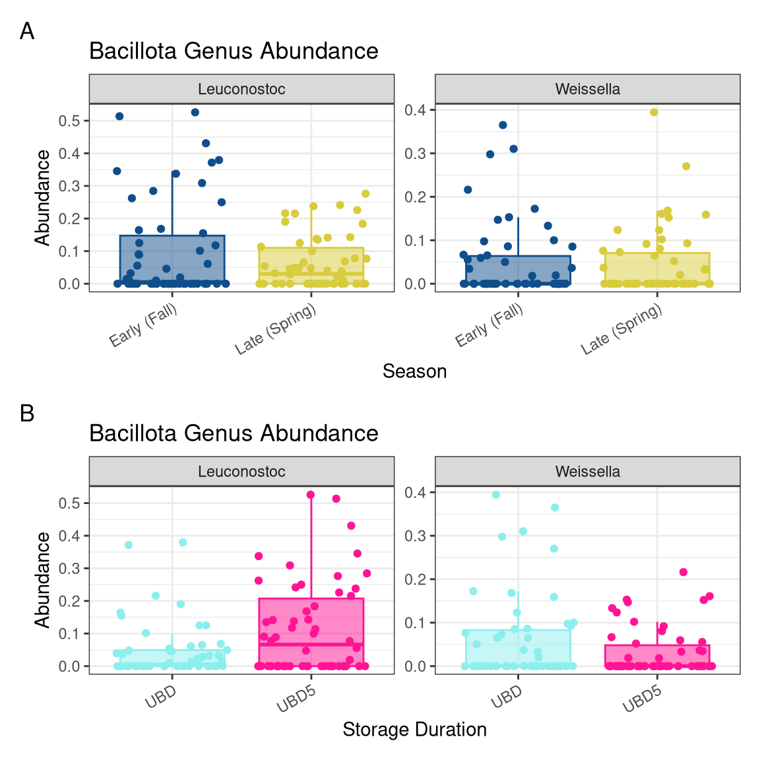
Leuconostoc: This genus showed higher abundance in Early Fall and a notable increase with extended storage (UBD5). While Bacillota appeared relatively stable across seasons and storage durations at the phylum level, Leuconostoc’s behavior suggests a potential role in spoilage or fermentation-like processes during storage.
Weissella: Showed a similar pattern - slightly higher in Fall and slightly decreasing during storage. This again contrasts with the phylum-level stability and implies that some Bacillota genera may be outcompeted or suppressed as storage progresses.

Slide 13
Compositional Analysis
Dominant phylum: Pseudomonadota
Key genera: Pseudomonas, Pantoea, and Enterobacter
Seasonal Differences:
Early season: more Pseudomonas.
Late season: more Enterobacteriaceae.
Storage Effects:
UBD+5 samples: Increase in spoilage-associated bacteria.
Notes:
In this part, we examined the relative abundances of major bacterial groups across seasons and storage times.
Across all samples, Proteobacteria was the dominant phylum, consistent with previous studies of fresh produce microbiota. Within Proteobacteria, genera like Pseudomonas and Pantoea were particularly abundant.
Now, when comparing seasons, we observed some interesting patterns:
Early-season lettuce showed a higher relative abundance of Pseudomonas species.
Late-season lettuce exhibited more Enterobacteriaceae, including genera like Pantoea and Enterobacter.
This seasonal difference suggests that environmental conditions during harvest — such as temperature and moisture — may shape the initial microbiota on lettuce.
When we examined the effect of storage time, comparing samples at the Use By Date (UBD) and five days after (UBD+5):
There was an increase in the abundance of spoilage-associated genera like Pseudomonas after 5 days of storage.
Pantoea tended to remain stable or slightly increase in some samples.
This suggests that storage beyond the Use By date allows opportunistic spoilage organisms, particularly psychrotolerant bacteria, to grow and dominate.
Overall, microbial composition shifted both with season and storage time, but the changes after the Use By date were particularly notable for spoilage-associated taxa.

Slide 14
Interpretation
Seasonality shapes starting microbiota.
Storage beyond UBD allows predictable spoilage-driven shifts.
Pseudomonas becomes more dominant after extended storage.
Implication:
Microbial evolution is not random after UBD; certain groups thrive.

Slide 15
Future Directions

Slide 16
Conclusion
Both season and storage time significantly affect microbial quality.
Extended storage past UBD favors spoilage-associated genera.
Findings can inform better shelf life assessments and reduce unnecessary food waste.
Notes:
To summarize:
Both seasonality and storage duration significantly influenced the microbial communities of bagged chopped Romaine lettuce.
Season affected the initial composition — early-season products had more Pseudomonas, while late-season products had more Pantoea and other Enterobacteriaceae.
Storage beyond the Use By Date resulted in further shifts toward spoilage-associated bacteria, particularly an increase in Pseudomonas.
These findings suggest that even after the Use By date, the microbial changes are systematic and dominated by predictable spoilage organisms, rather than random contamination.
Understanding these microbial dynamics can help better inform date labeling practices, storage recommendations, and consumer guidance to reduce unnecessary food waste without compromising food safety.
Thank you for listening! I’d be happy to take any questions.

